Slide 1
Working with Database

Slide 2
Introduction
In order to use ADO.NET, we must first decide which kind of database we’ll use .
Since we’re using SQL Server, you’ll need to import the
System.Data.SqlClient namespace. This contains all the required Sql classes, the most important of which are:
SqlConnection : This class exposes properties and methods for connecting to an SQL Serverdatabase.
SqlCommand This class holds data about the SQL queries and stored procedures that you in-tend to run on your SQL Server database.
SqlDataReaderData is returned from the database in an SqlDataReader class..

Slide 3
Defining the Database Connection
create a new instance of the SqlConnection, which will facilitate our connection to the database.
A typical connection string for an SQL Server Express database looks like this:
The connection string must specify the name of the server on which the database is located.
we also specify the database we want to connect to, and provide any required authentication details (the user ID, and the password for that user account).

Slide 4
Defining the Database Connection (Cont.)
SQL Server supports two methods of authentication: SQL Server Authentication and Windows Authentication.
The form of authentication to connect to SQL Server Windows Authentication, which doesn’t require you to supply a SQL Server name and password, but instead uses the credentials of your Windows user account.
To tell SQL Server that we’re logging in using Windows Authentication, we’d use a connection string that included Integrated Security=True,
The form of authentication to connect to SQL Server is SQL Server Authentication
, which require you to supply a SQL Server name and password

Slide 5
Defining the Database Connection Example
1- new connection (connection string)
// using SQL express local server and database university
SqlConnection conn = new SqlConnection("Data Source=localhost\\SqlExpress;
Initial Catalog=university;Integrated Security=True");
//Using local mdf database
SqlConnection conn1 = new SqlConnection("Data Source=(LocalDB)\\MSSQLLocalDB;AttachDbFilename=|DataDirectory|\\dd.mdf;Integrated Security=True");

Slide 6
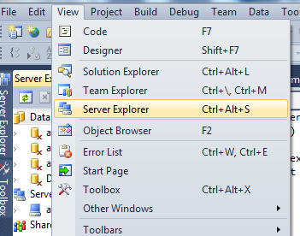
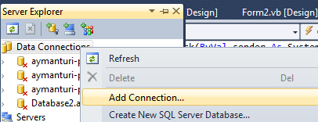
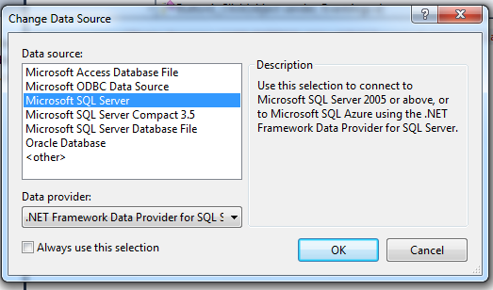
Creating Database Using SQL express In Visual.NET

Slide 7
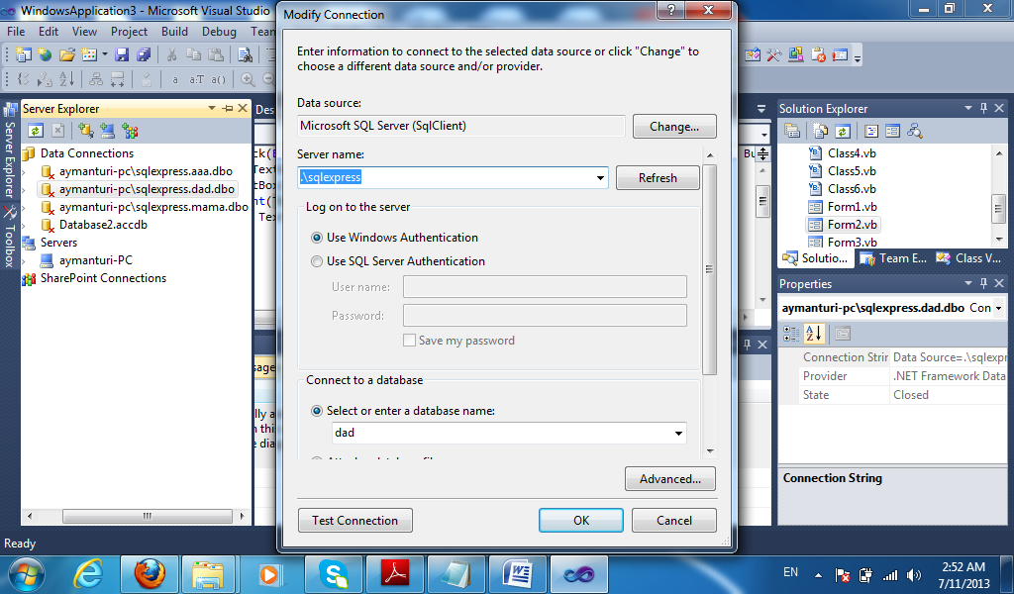

Slide 8
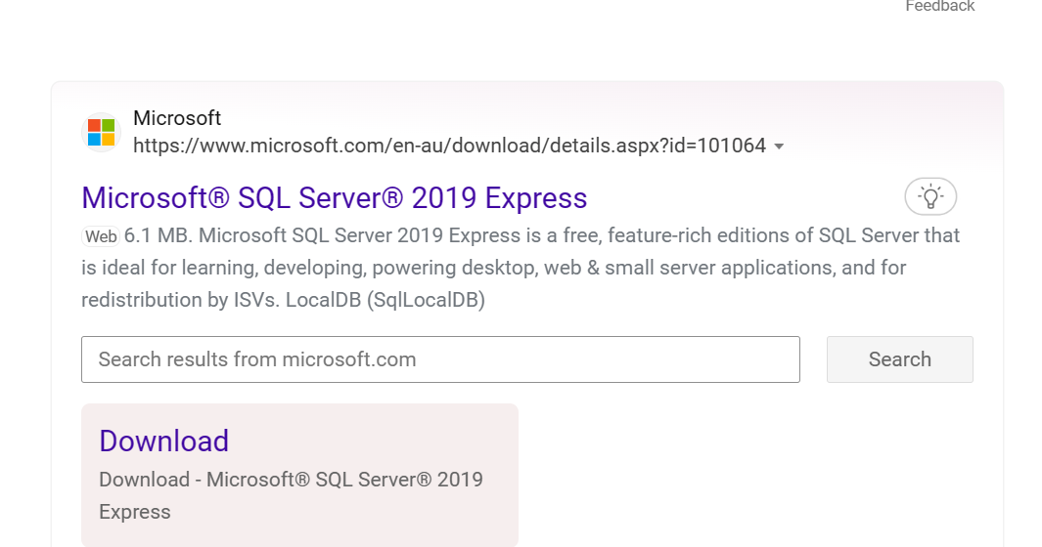
Note:
If Sql server not found error occur , make sure that Sql express is installed

Slide 9
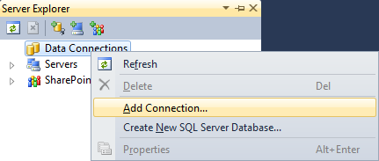
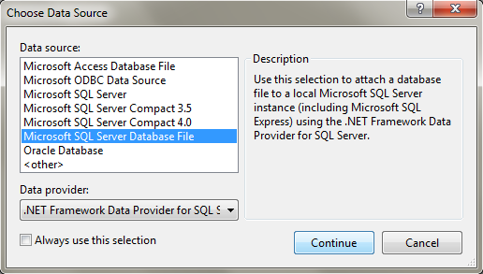
Creating Tables using local mdf database

Slide 10
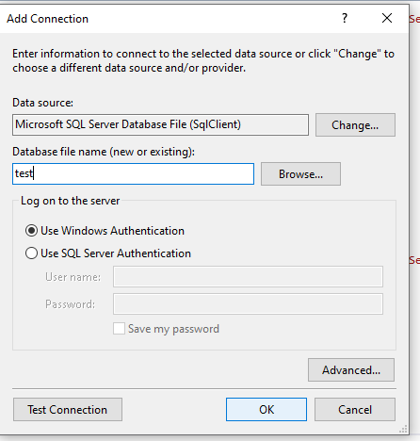
Enter the DB name

Slide 11
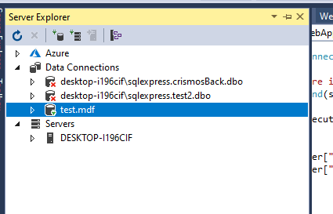
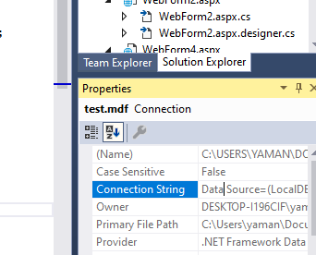
Getting the Connection String
Data Source=(LocalDB)\MSSQLLocalDB;AttachDbFilename=C:\Users\yaman\Documents\test.mdf;Integrated Security=True;Connect Timeout=30
Add \ to \\ at the connection string
Data Source= (LocalDB)\\MSSQLLocalDB;AttachDbFilename=C:\\Users\\yaman\\Documents\\test.mdf;Integrated Security=True;Connect Timeout=30

Slide 12
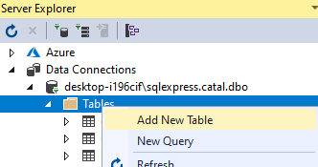
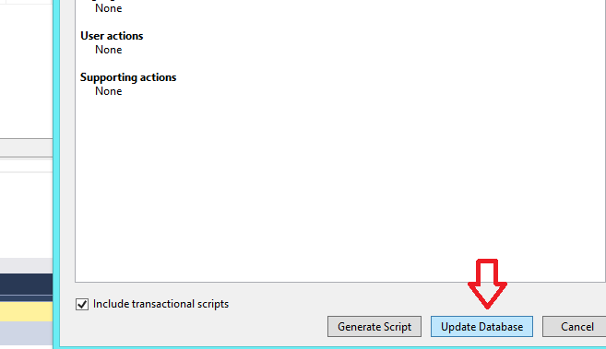
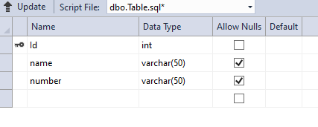
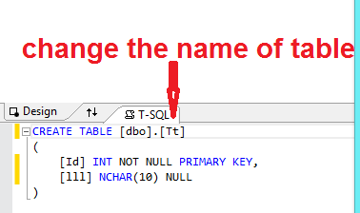
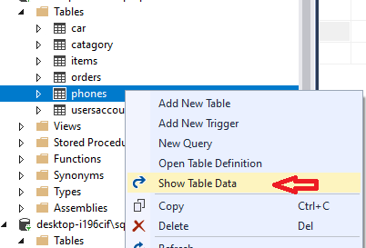
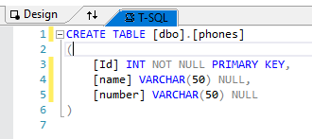
Creating a table
1
4
2
3
5
To fill table with data

Slide 13
2. Preparing the Command
Now we’re at step three, in which we create an SqlCommand object and pass in our SQL statement.
The SqlCommand object accepts two parameters. The first is the SQL statement, and the second is the connection object that we created in the previous step:

Slide 14
4. Executing the Command
The SqlCommand class has three methods that we can use to execute a command
ExecuteReader
ExecuteReader returns an SqlDataReader object that can be used to read the results of the query one by one, in a forward-only, read-only manner.
for each connection you can open only one SqlDataReader object
This can be a problem, as the database server will usually have a limited number of connections—people who are using your application simultaneously may start to see errors if you leave these connections open.

Slide 15
4. Executing the Command (Cont.)
ExecuteScalar
is used to execute SQL queries or stored procedures that return a single value, such as a query that counts the number of employees in a company.
ExecuteNonQuery
Is used to execute stored procedures and SQL queries that insert, delete, or update data. The return value will be the number of affected rows.

Slide 16
Steps of Getting data from DB using DataReader
1- new connection (connection string)
2- sql statement ( select ---
3- command sql command
4- open connection
4- data reader execute reader
6- close reader and connection

Slide 17
Getting record list from DB using DataReader
using System.Data.SqlClient;
….
// using SQL express database Example
SqlConnection conn = new SqlConnection("Data Source= localhost\\SqlExpress;Initial Catalog=;Integrated Security=True");
String sql;
sql = "SELECT * FROM phones";
SqlCommand comm = new SqlCommand(sql, conn);
conn.Open();
SqlDataReader reader = comm.ExecuteReader();
while (reader.Read())
{
string mm += (string)reader["Name"] + "<br />";
}
reader.Close();
conn.Close();

Slide 18
Getting a single record:
Example searching phone number based on his name
SqlConnection conn = new SqlConnection("Data Source= localhost\\SqlExpress;Initial Catalog=dad;Integrated Security=True");
string sql;
string mm = " ";;
sql = "SELECT * FROM phones where name = 'aiman' ";
SqlCommand comm = new SqlCommand(sql, conn);
conn.Open();
SqlDataReader reader = comm.ExecuteReader();
if (reader.Read())
{ mm = Convert.ToString((int)reader["number"]) ; }
else
{ mm = "no user found "; }
reader.Close();
conn.Close();

Slide 19
ExecuteScalar Example
1- new connection
2- sql statement (SELECT COUNT( Id) ---)
3- command sql command
4- execute ExecuteScalar command
4- close
Example : number of failed student in a class
sql = "SELECT COUNT( Id) FROM student where status =‘failed' and classid = ‘1200'";
comm = new SqlCommand(sql, conn);
int count = (int)comm.ExecuteScalar();
string mm = Convert.ToString(count);

Slide 20
Inserting/Update/Delete data
1- new connection
2- sql statement (insert/update/delete ---)
3- command sql command
4- execute non Query command
4- close

Slide 21
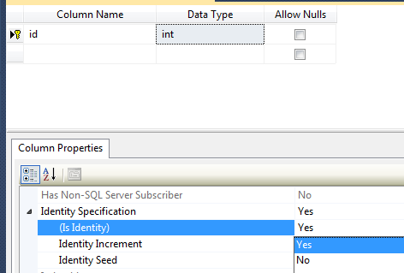
Working with ID
ID should be auto incremented in the database and no need to include it in a textbox or in the insert statement ;

Slide 22
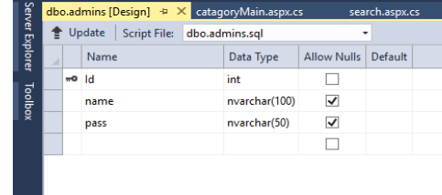
Dealing with Arabic Characters
e.g. 1
string sql = "insert into admins(name,pass) " +
"values (N'" + TextBox1.Text + "',N'" + TextBox2.Text + "')";
e.g.2
sql = "SELECT * FROM customer where name =N'" + TextBox1.Text + "'";

Slide 23

Working with Date
To set the default date to today when inserting new record table use (getdate())
to get the date from the system
DateTime d1,d2;
d1 = DateTime.Now; // GETTING DATE TIME
d2 = DateTime.Today; //GETTING DATE
To get the date and time string
string mm = d1.ToString("yyyy-MM-dd HH:mm:ss");
To get only date string
string mm = d2.ToString("yyyy-MM-dd");

Slide 24
Working with Date
to get last month
string PastMonthDate = DateTime.Today.AddDays(-30).ToString();
to get the month or year string currentMonth = DateTime.Today.Month.ToString(); string currentYear = DateTime.Today.Year.ToString()
e.g., Reading all record created in this year
Select FROM registrations WHERE year = '" + currentYear + "' ";
e.g., Reading Back the registration Date from a database
if (reader.Read())
{
DateTime d1 = (DateTime)reader["redate"];
string mm = d1.ToString("yyyy-MM-dd"); } //
reader.Close();

Slide 25
Working with Database
Control-View Approach

Slide 26
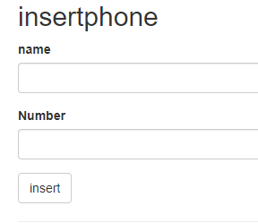
1- Add the insertphone action at HomeController
Insert Example
Right Click to create Empty view

Slide 27
2- Add this code at the insert phone view
Insert Example
Insertphone.cshtml
To display Successfully added message

Slide 28
3- complete the insertphone action and add PostHttp insert phone action
Insert Example
HomeController.cs

Slide 29
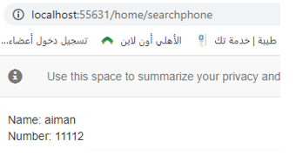

Search Example
Search Phone based on its id

Slide 30

Search Example
1-Complete the search phones action
Right Click to create Empty view
HomeController.cs
Getting data from database and send it to the View using ViewData object

Slide 31
2-Complete the search phone view
Search Example
Searchphone.cshtml

Slide 32
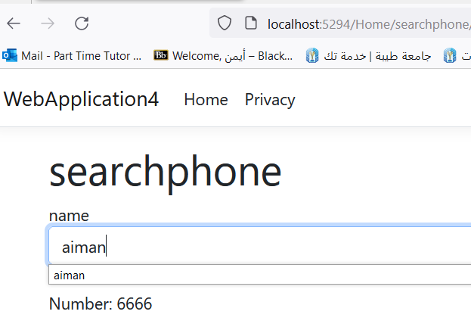
Search Example
Searching phone by name
Onchange event

Slide 33
Search Example
2-update the search phones action at the HomeController
HomeController.cs

Slide 34
3-update the search phone view to include the searching form
Search Example
Searchphone.cshtml

Slide 35

For better maintenance: make one common connection string accessible for all pages
{
"Logging": {
"LogLevel": {
"Default": "Information",
"Microsoft.AspNetCore": "Warning"
}
},
"ConnectionStrings": {
"WebApplication31Context": "Data Source=.\\sqlexpress;Initial Catalog=mynewdb;Integrated Security=True;Pooling=False"
},
"AllowedHosts": "*"
}
The appsettings.json file stores configuration settings for your app.

Slide 36
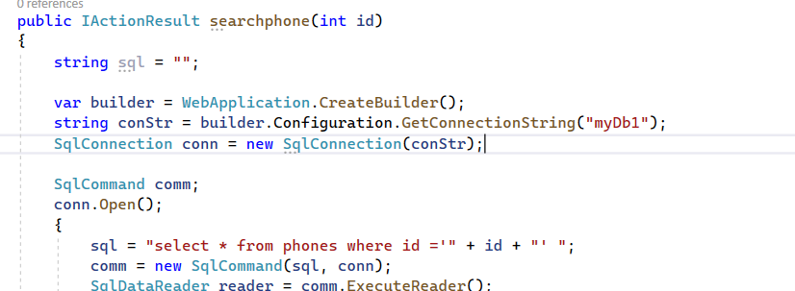
SqlConnection conn = new SqlConnection("Data Source=.\\sqlexpress;Initial Catalog=mynewdb;Integrated Security=True");
Replace this connection string

Slide 37
To make one common connection string accessible at all actions
var builder = WebApplication.CreateBuilder();
string conStr = builder.Configuration.GetConnectionString(" WebApplication31Context");
SqlConnection conn = new SqlConnection(conStr);

Slide 38
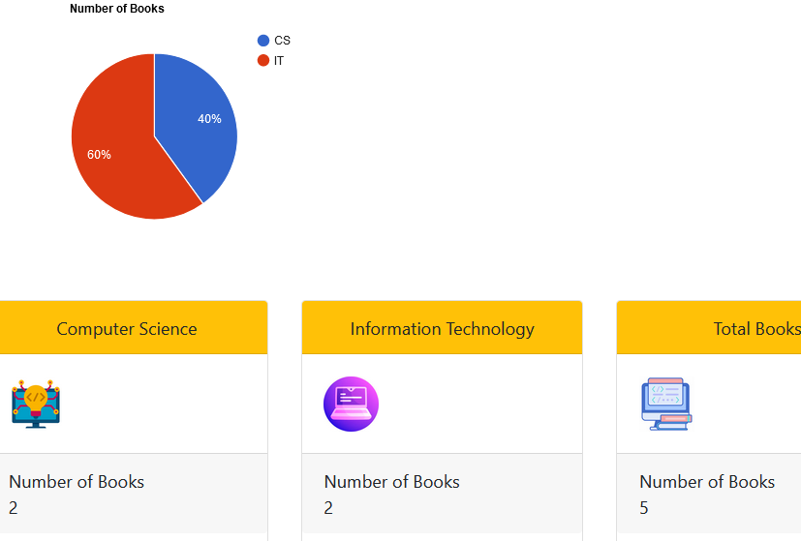
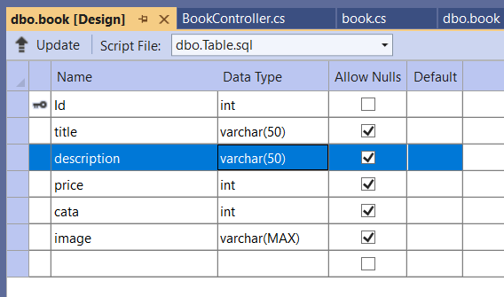
Example4 Using Google Chart within a Dashboard
CREATE TABLE [dbo].[book]
(
[Id] INT NOT NULL PRIMARY KEY IDENTITY,
[title] VARCHAR(50) NULL,
[description] VARCHAR(50) NULL,
[price] INT NULL,
[cata] INT NULL,
[image] VARCHAR(MAX) NULL
)
Fill in some data manually

Slide 39
Getting the number of books in each category
1-Create a the statis action: with this code to get the book count for each book category
HomeController.cs
Right Click to create view
Getting the statistical Data

Slide 40
2- the statis view code to draw the google chart based on received category values
statis.cshtml
Filling table with data
ColumnChart:To Change the PieCahrt to ColumnChart

Slide 41
Dashboard cards showing number of item in each category

Slide 42
Working with Database
Model-Control-View Approach
Action
View
Return view(Model Object)
Table Data
A model is a regular C# class that is typically stored in the Models folder that is used to send the data to a view page from a database table

Slide 43
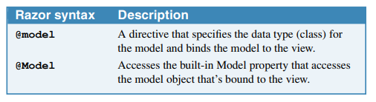
Sending a single object (using model)
object
ph.name = “Aiman”
ph.number = 66666
object Class
Project Name
Action
View
@model webApplication.Phone
return view(ph)
@Model.name → “Aiman”
@Model.number → 66666

Slide 44
Sending a list of objects (using model)
List of objects
@model Ienuramable <webApplication.Phones>
View
Action
return view(phList)
@foreach (var item in Model)
{
<tr>
<td>@item.name</td>
<td>@item.number</td>
</tr>
}

Slide 45
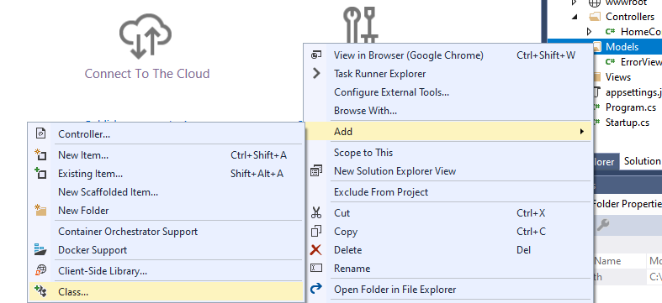
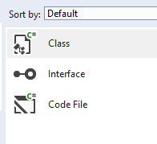
1- Adding phone Class
Example: Displaying a single Object using Model

Slide 46
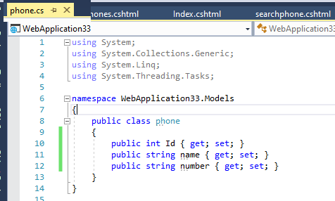
1- Adding phone Class
Example: Displaying a single Object using Model
Creating phone class according to the phones table
public class phone
{
public int id { get; set; }
public string name { get; set; }
public string number { get; set; }
}
All Model Classes should have Id attribute

Slide 47
Example: Displaying a single Object using Model
2-Create the search phones action at the HomeController that returns phone object containing the name and phone
HomeController.cs
Model Class object
Returning the phone object to the view

Slide 48
3-Right click the action and add the search phone view
Example: Displaying a single Object using Model
Class location
Searchphone.cshtml

Slide 49
Using @Html.DisplayFor
Difference between @Html.DisplayFor and @Model
@Html.DisplayFor is a more robust and safe way to display a property, since it takes care of formatting and validation,
1- @Html.DisplayFor: Allow retrieving Null object’s reference
return view(ph) √
return view() √
2- @Model
return view(ph) √
return view()
@ Model Doesn't allow retrieving Null Object’s value

Slide 50
For Displaying attribute Name @Html.DisplayNameFor(model => model.attribute) For Displaying attribute Value @Html.DisplayFor(model => model.attribute)
Displaying Object’s values using @Html.Display

Slide 51
update the action code for search phone view
Displaying Object’s values using @Html.Display
Searchphone.cshtml

Slide 52
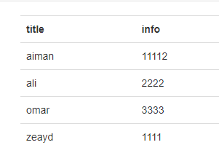
Displaying Object’s values using @Html.Display
Example: Get All phones (list of objects)

Slide 53
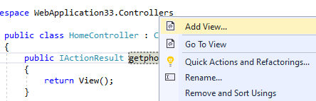
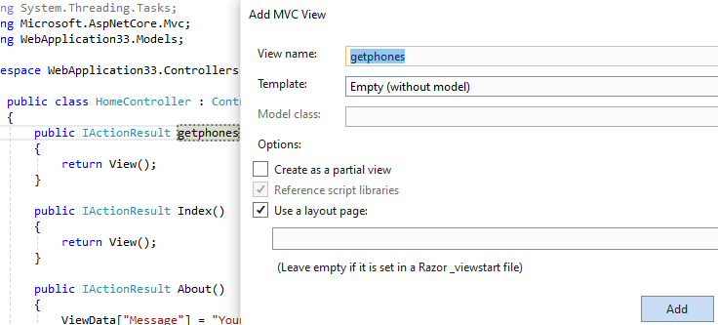
Displaying Object’s values using @Html.Display
1- Add getphone action to show all data records
HomeController.cs
2- Right click the getphone action to add an empty get phone view

Slide 54
3- Complete the get phones action that reads all phones table data into phones list objects
Displaying Object’s values using @Html.Display
HomeController.cs
Returning list of phones objects to the view

Slide 55
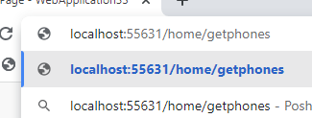
4-Complete the get phones view to display the phones lists object
Displaying Object’s values using @Html.Display
Getphones.cshtml
Run the Project

Slide 56

Using asp-for within forms (better approach especially for editing and inserting)
Form
name
action
value
asp-for

Slide 57
1- Add the edit phone action to fill view data according to the received id using ph obj
Using asp-for within forms
Example: Edit phone

Slide 58

Note before continuing
Using asp-for within forms
Using Hidden Fields to Send data (not to be changed by user such as Id)
View
Hidden Field id
Name Field
……..
Id
Id
Action 2
Action 1
Other
Filed
Name,.
Can be updated by user
Other
Filed
Name,..

Slide 59
Using asp-for within forms
2- Add the edit phone view
Editphone.cshtml
Hidden Field

Slide 60
3- Add the edit phone HttpPost action to update the phone data in the database
Using asp-for within forms
Binding form input fields to ph object

Slide 61
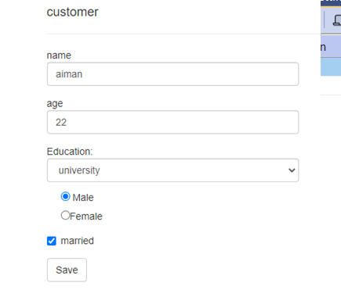
Using asp-for within forms
Example: Registration forms

Slide 62

Using asp-for within forms
public class customer
{
public int id { get; set; }
public string name { get; set; }
public int age { get; set; }
public string education { get; set; }
public string gender { get; set; }
public Boolean married { get; set; }
}
Create the customer class and table
CREATE TABLE [dbo].[customer] (
[Id] INT IDENTITY (1, 1) NOT NULL,
[name] VARCHAR (50) NULL,
[age] INT NULL,
[education] VARCHAR (50) NULL,
[married] BIT NULL,
[gender] VARCHAR (50) NULL,
PRIMARY KEY CLUSTERED ([Id] ASC)
);

Slide 63
1- Add the registration action to show the registration form and to process the its input
HomeController.cs
Check if the
customer already exists

Slide 64
2- Add the registration view
registration.cshtml

Slide 65

Implementing the Edit customer functionality based on its id
Using asp-for within forms

Slide 66
1- Add the edit action to fill view data according to the received id via cust data object
Using asp-for within forms
HomeController.cs

Slide 67
2- Add the edit view
Edit.cshtml

Slide 68
3- Add the HttpPost edit action to update the customer data in the database
HomeController.cs

Slide 69
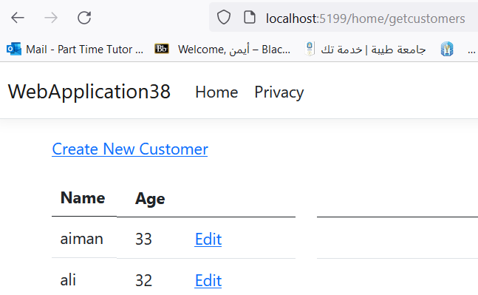
Example getting all customers details
Using asp-for within forms

Slide 70
1- Add the get customers action: to get all customers from DB into objects List
HomeController.cs

Slide 71
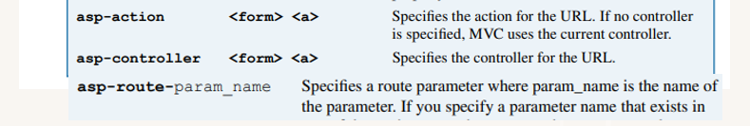
2- Add the get customers view
getcustomers.cshtml

Slide 72


Adding a New Attribute to the Model
1 - add location attribute to the table
2 - add location to the model
3 – Delete all previous records from the table because null will generate runtime error

Slide 73
Adding New Attributes to the controller
4 - add location input to Registration and Edit Action
public async Task<IActionResult> Create([Bind(("name,age,education,gender,married ,location ")] customer cust)
public async Task<IActionResult> Edit(int id, [Bind("Id, ("name,age,education,gender,married,location")] customer cust)
5 - add location input to Registration and Edit views
<div class="form-group">
<label asp-for="location" class="control-label"></label>
<input asp-for="location" class="form-control" />
<span asp-validation-for="location" class="text-danger"></span>
</div>
6 - add location data to Search view
<dd class = "col-sm-10">
@Html.DisplayFor(model => model.location)
</dd>
7 - add location data to getcustomers view
<th>
@Html.DisplayNameFor(model => model.location)
</th>
<td>
@Html.DisplayFor(modelItem => item.location)
</td>

Slide 74
How to set data validation rules in the model
The first step in validating the data that a user enters is to set data validation rules in the model as described in next slide.
To start, you can import the DataAnnotations namespace.
Then, you can use the validation attributes from that namespace to set the data validation rules.
The two of the most common validation attributes. First, you can code the Required attribute above a property to indicate that a value is required for that property.
Second, you can code the Range attribute above a property to indicate that the value for that property must be within the specified range of values.
To make a non-nullable data type nullable, you can code a question mark (?) after the data type as shown in the first example. Then, if the user doesn’t enter a value for this property, the MVC framework generates a default error message.

Slide 75
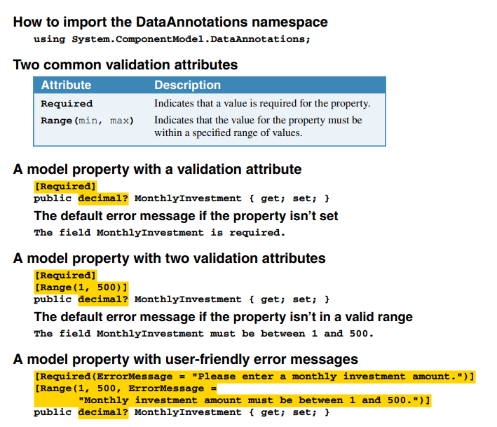
How to set data validation rules in the model

Slide 76
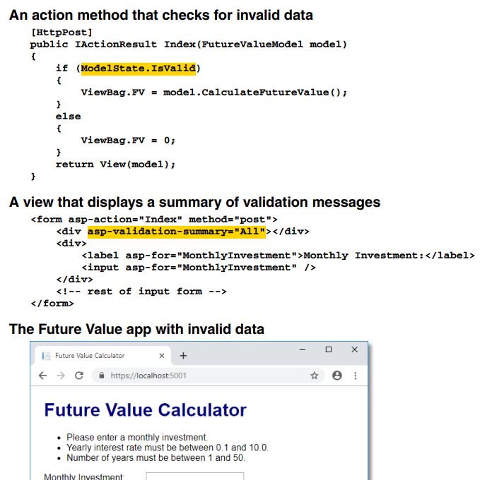
How to display validation error messages

Slide 77
Razor layout for a multi-page web app project
it’s common to have headers, footers, and navigation bars that are displayed on all or most pages of a web app.
In other words, it’s common to have HTML elements that are common to all pages.
In that case, it’s a good practice to store the elements that are common to multiple pages in separate files.
This allows you to keep a consistent look across all pages, and it makes your app easier to maintain.
To store elements that are common to multiple pages in a separate file, you can add a Razor layout to your web app .
A Razor layout provides a way to store elements that are common to multiple web pages in a single file.
If necessary, you can override the default layout for any views as described in the next figure.

Slide 78
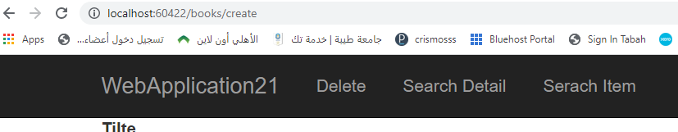
Creating New Layouts
Layouts in MVC are similar to Master Pages in Web Forms
In many cases you might need to have multiple menus or navigation bars (admin, customers, etc.)
Example: Creating New Layouts to be used for the books views

Slide 79
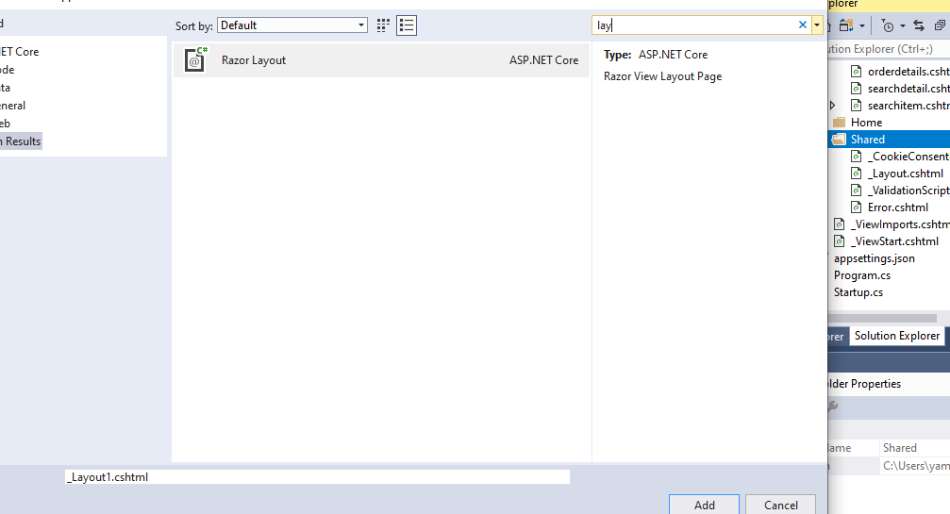
1- Right Click the share folder and add new item
2-search for layout
3

Slide 80

4- Copy Paste Page content
5-Add new menu items data
<nav class="navbar navbar-expand-sm bg-dark navbar-dark">
<ul class="navbar-nav">
<li> <a class="nav-link" asp-controller="books"asp-action="Index" > List</a></li>
<li><a class="nav-link" asp-controller="books"asp-action="Create" >Create</a></li>
<li > <a class="nav-link" asp-controller="books"asp-action="Catalog" >Catalog</a></li>
<li><a class="nav-link" asp-controller="books"asp-action="Slider" >Slider</a></li>
</ul>
</nav>

Slide 81
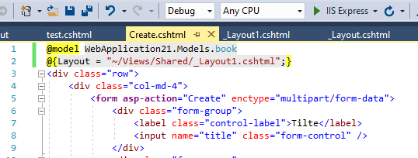
6-Add layout statement to each Book view
Create.cshtml
@{Layout = "~/Views/Shared/_Layout1.cshtml";}
Note: for no menu (e.g. login view)
@{ Layout = null;}

